Slide 1
Traditional Features for Machine Learning in Graphs

Slide 2
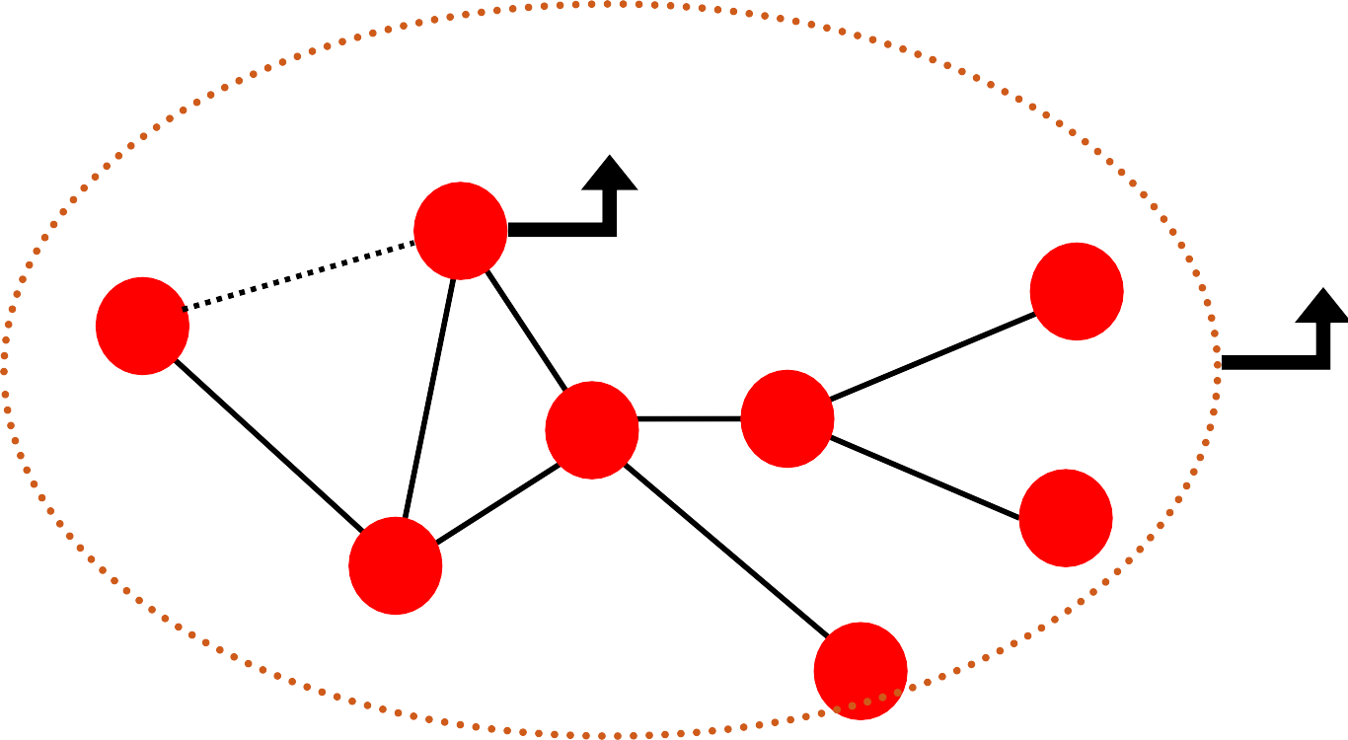
Node-level prediction
Link-level prediction
Graph-level prediction
? Node-level
Link-level
Graph-level
?
B
?
F
A
D
E
G
C
H
2

Slide 3
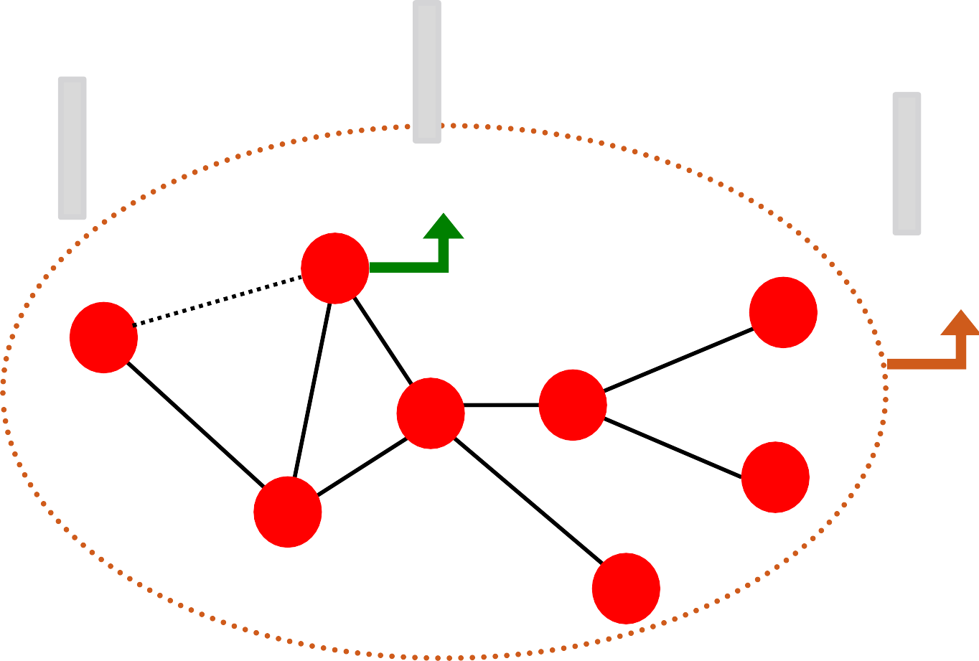
Design features for nodes/links/graphs
Obtain features for all training data
∈ ℝ^{D}
∈ ℝ^{D}
Node features
B
∈ ℝ^{D}
Link features
A
Graph features
F
D
E
G
C
H
3

Slide 4
Train an ML model:
Random forest
SVM
Neural network, etc.
𝒙_{𝟏} 𝑦₁
Apply the model:
Given a new node/link/graph, obtain its features and make a prediction
𝒙 𝑦
𝒙_{𝑵}
𝑦_{N}
4

Slide 5
Using effective features over graphs is the key to achieving good test performance.
Traditional ML pipeline uses hand-designed features.
In this lecture, we overview the traditional features for:
Node-level prediction
Link-level prediction
Graph-level prediction
For simplicity, we focus on undirected graphs.
5

Slide 6
Goal: Make predictions for a set of objects
Design choices:
Features: d-dimensional vectors
Objects: Nodes, edges, sets of nodes, entire graphs
Objective function:
What task are we aiming to solve?
6

Slide 7
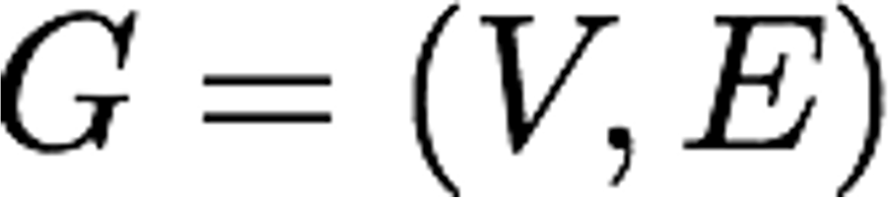
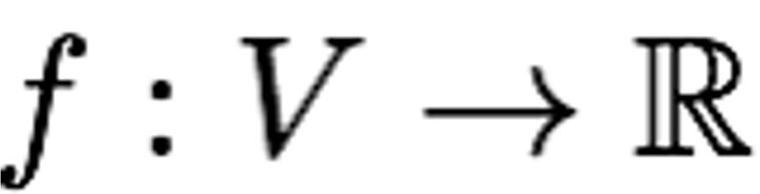
Machine learning in graphs:
Given:
Learn a function:
How do we learn the function?
7

Slide 8
Node-level Tasks and Features

Slide 9



?
?
?
?
Machine Learning
?
Node classification
ML needs features.
9

Slide 10
Goal: Characterize the structure and position of a node in the network:
Node degree
Node centrality
Clustering coefficient
Graphlets
A
Node feature
B
F
D
E
G
C
H
10

Slide 11
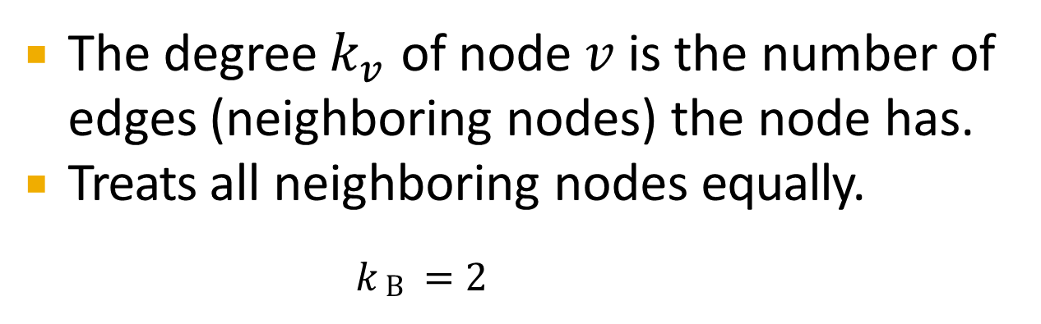
The degree $k_{v}$ of node 𝑣 is the number of edges (neighboring nodes) the node has.
Treats all neighboring nodes equally.
𝑘_{B} = 2
𝑘_{A} = 1
A
B
𝑘_{D}= 4
F
D
E
G
C
𝑘_{C} = 3
H
11

Slide 12
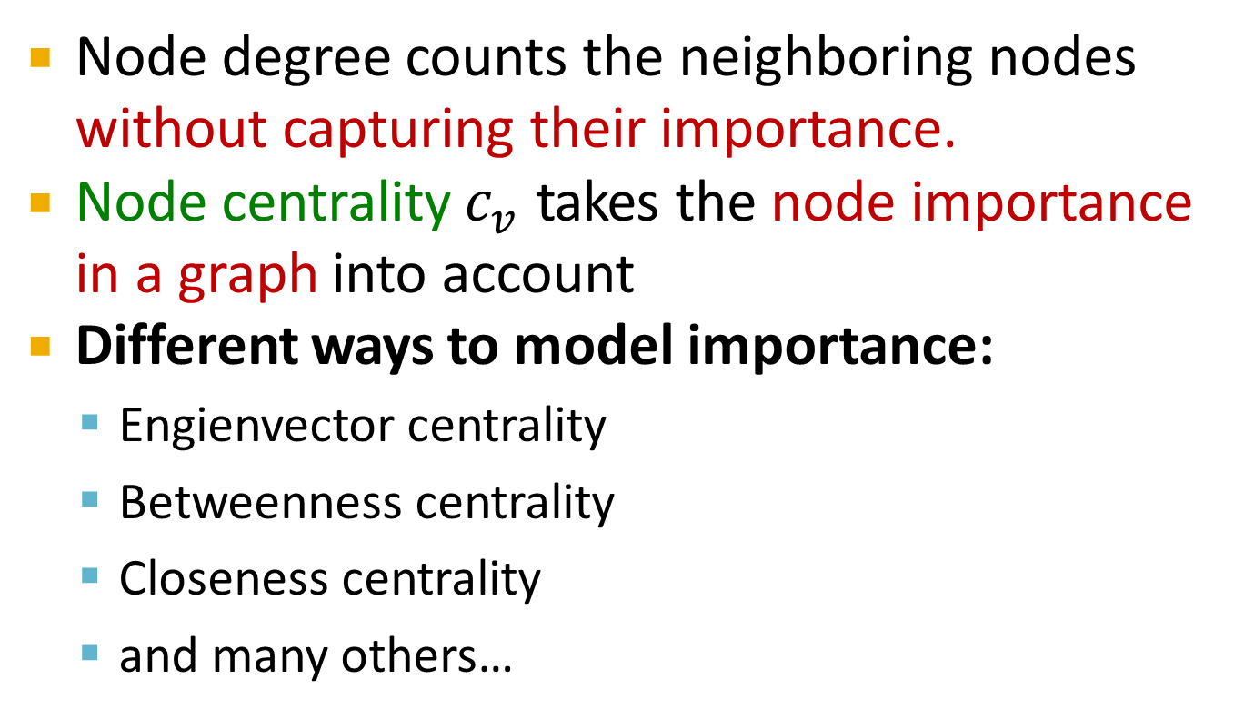
Node degree counts the neighboring nodes without capturing their importance.
Node centrality $c_{v}$ takes the node importance in a graph into account
Different ways to model importance:
Engienvector centrality
Betweenness centrality
Closeness centrality
and many others…
12

Slide 13

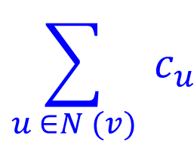
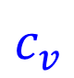
Eigenvector centrality:
A node 𝑣 is important if surrounded by important neighboring nodes 𝑢 ∈ 𝑁(𝑣).
We model the centrality of node 𝑣 as the sum of the centrality of neighboring nodes:
₌ 1
$$\sum_{u ∈N (v)}{{ c}_{u}}$$
$$c_{v}$$
𝜆
𝜆 is some positive constant
Notice that the above equation models centrality in a recursive manner. How do we solve it?
13

Slide 14
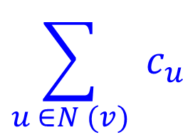
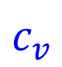
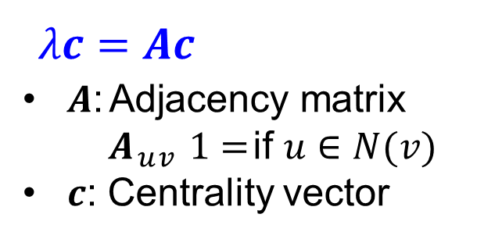
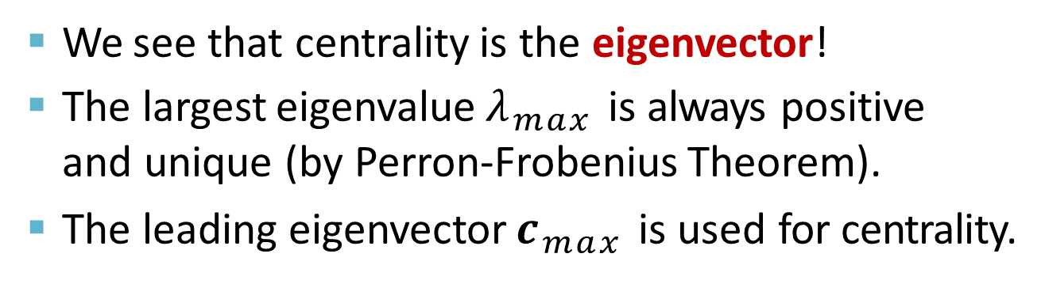
Eigenvector centrality:
Rewrite the recursive equation in the matrix form.
₌ 1
$$\sum_{u ∈N (v)}{{ c}_{u}}$$
$$c_{v}$$
𝜆𝒄 = 𝑨𝒄
𝑨: Adjacency matrix
$A_{uv}$= 1 if 𝑢 ∈ 𝑁(𝑣)
𝒄: Centrality vector
𝜆
𝜆 is some positive constant
We see that centrality is the eigenvector!
The largest eigenvalue $λ_{max}$is always positive and unique (by Perron-Frobenius Theorem).
The leading eigenvector $c_{max}$is used for centrality.
14

Slide 15
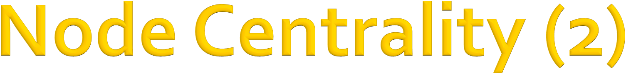
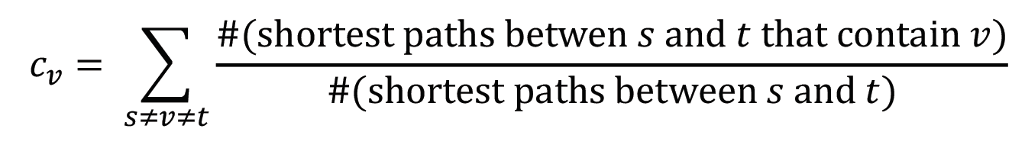
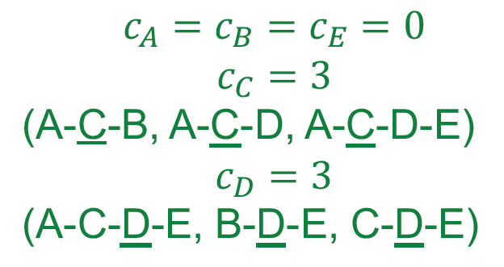
Betweenness centrality:
A node is important if it lies on many shortest paths between other nodes.
Example:
B
A
D
E
C

Slide 16

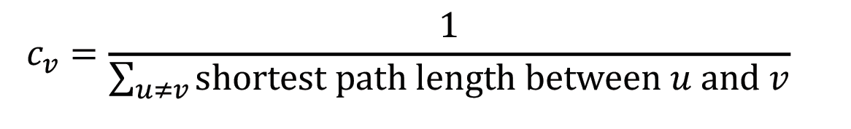
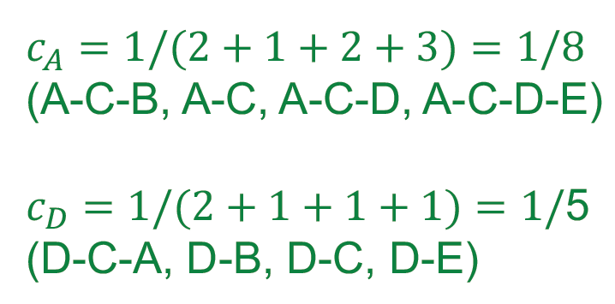
Closeness centrality:
A node is important if it has small shortest path lengths to all other nodes.
Example:
B
A
D
E
C
16

Slide 17
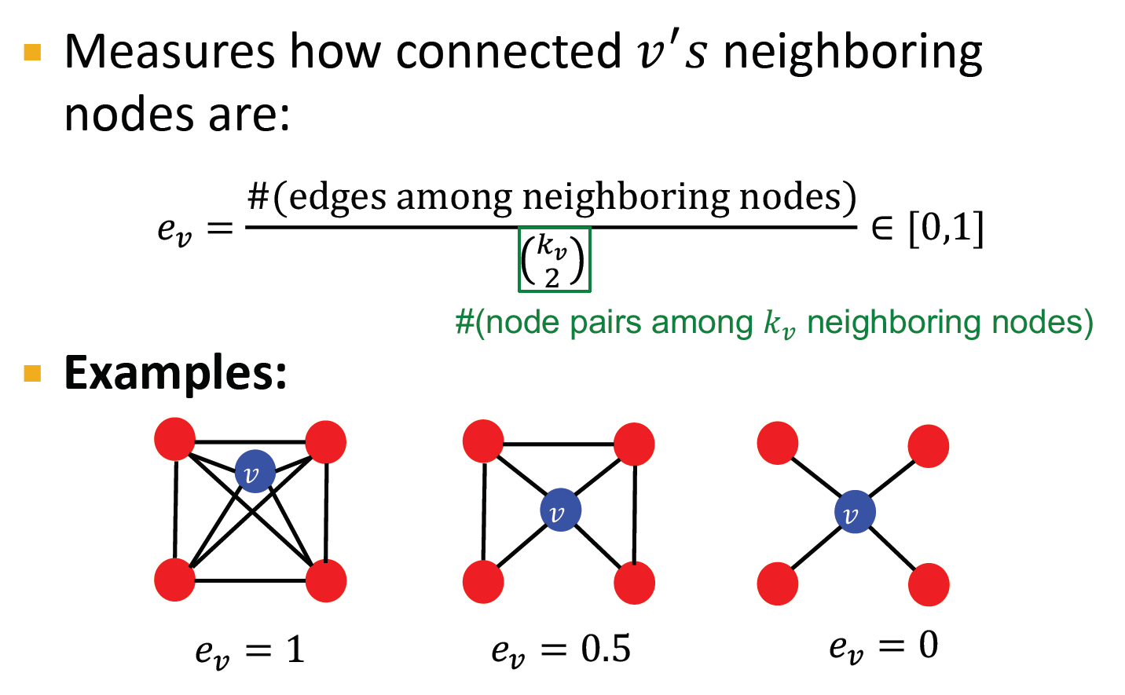

Slide 18
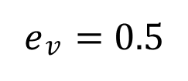
Observation: Clustering coefficient counts the #(triangles) in the ego-network
𝑣
𝑣
𝑣
𝑣
𝑒$v$ = 0.5
3 triangles (out of 6 node triplets)
We can generalize the above by counting #(pre-specified subgraphs, i.e., graphlets).
18

Slide 19
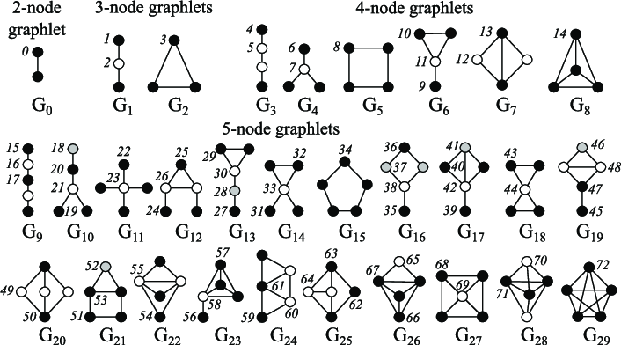
Graphlets: Rooted connected non-isomorphic subgraphs:
Przulj et al., Bioinformatics 2004
19

Slide 20
Graphlet Degree Vector (GDV): Graphlet-base features for nodes
Degree counts #(edges) that a node touches
Clustering coefficient counts #(triangles) that a node touches.
GDV counts #(graphlets) that a node touches
20

Slide 21
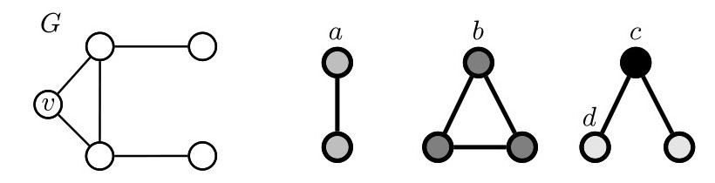

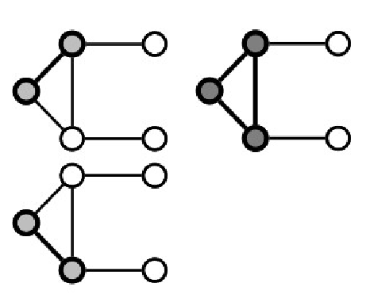
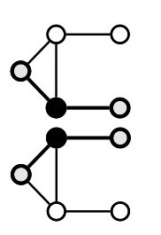
Graphlet Degree Vector (GDV): A count vector of graphlets rooted at a given node.
Example:
𝑣
List of graphlets
Graphlet instances:
𝑎 𝑐
𝑏
𝑑
GDV of node 𝑣:
𝑎, 𝑏, 𝑐, 𝑑
[2,1,0,2]

Slide 22
Considering graphlets on 2 to 5 nodes we get:
Vector of 73 coordinates is a signature of a node that describes the topology of node's neighborhood
Captures its interconnectivities out to a distance of 4 hops
Graphlet degree vector provides a measure of a node’s local network topology:
Comparing vectors of two nodes provides a more detailed measure of local topological similarity than node degrees or clustering coefficient.
22

Slide 23

We have introduced different ways to obtain node features.
They can be categorized as:
Importance-based features:
Node degree
Different node centrality measures
Structure-based features:
Node degree
Clustering coefficient
Graphlet count vector
23

Slide 24
Importance-based features: capture the importance of a node in a graph
Node degree:
Simply counts the number of neighboring nodes
Node centrality:
Models importance of neighboring nodes in a graph
Different modeling choices: eigenvector centrality, betweenness centrality, closeness centrality
Useful for predicting influential nodes in a graph
Example: predicting celebrity users in a social network
24

Slide 25
Structure-based features: Capture topological properties of local neighborhood around a node.
Node degree:
Counts the number of neighboring nodes
Clustering coefficient:
Measures how connected neighboring nodes are
Graphlet degree vector:
Counts the occurrences of different graphlets
Useful for predicting a particular role a node plays in a graph:
Example: Predicting protein functionality in a protein-protein interaction network.
25

Slide 26
Link Prediction Task and Features

Slide 27
The task is to predict new links based on existing links.
At test time, all node pairs (no existing links)
are ranked, and top 𝐾 node pairs are predicted.
The key is to design features for a pair of nodes.
?
B
F
A
D
E
G
C
?
H

Slide 28

















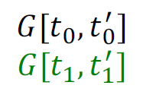
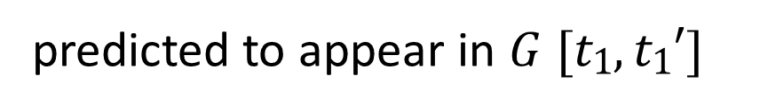



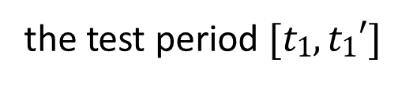
Two formulations of the link prediction task:
1) Links missing at random:
Remove a random set of links and then aim to predict them
2) Links over time:
Given 𝐺[𝑡₀, 𝑡₀$′$] a graph on edges
up to time 𝑡₀$′$,output a ranked list
L
of links (not in 𝐺 [𝑡₀, 𝑡₀$′$] that are
predicted to appear in 𝐺 [𝑡₁, 𝑡₁$′$]
Evaluation:
n = |E_{new}|: # new edges that appear during
the test period [𝑡₁, 𝑡₁$′$]
Take top n elements of L and count correct edges

Slide 29













Methodology:
For each pair of nodes (x,y) compute score c(x,y)
For example, c(x,y) could be the # of common neighbors of x and y
Sort pairs (x,y) by the decreasing score c(x,y)
Predict top n pairs as new links
See which of these links actually
X
appear in 𝐺 [𝑡₁, 𝑡₁$′$]
X

Slide 30
Distance-based feature
Local neighborhood overlap
Global neighborhood overlap
Link feature
A
B
F
D
E
G
C
H

Slide 31
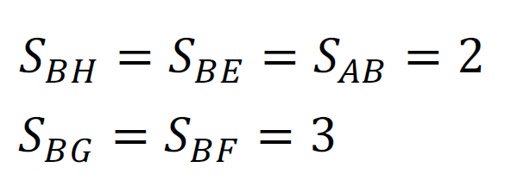
Shortest-path distance between two nodes
Example:
B
A
F
D
E
G
C
H
However, this does not capture the degree of
neighborhood overlap:
Node pair (B, H) has 2 shared neighboring nodes, while pairs (B, E) and (A, B) only have 1 such node.

Slide 32
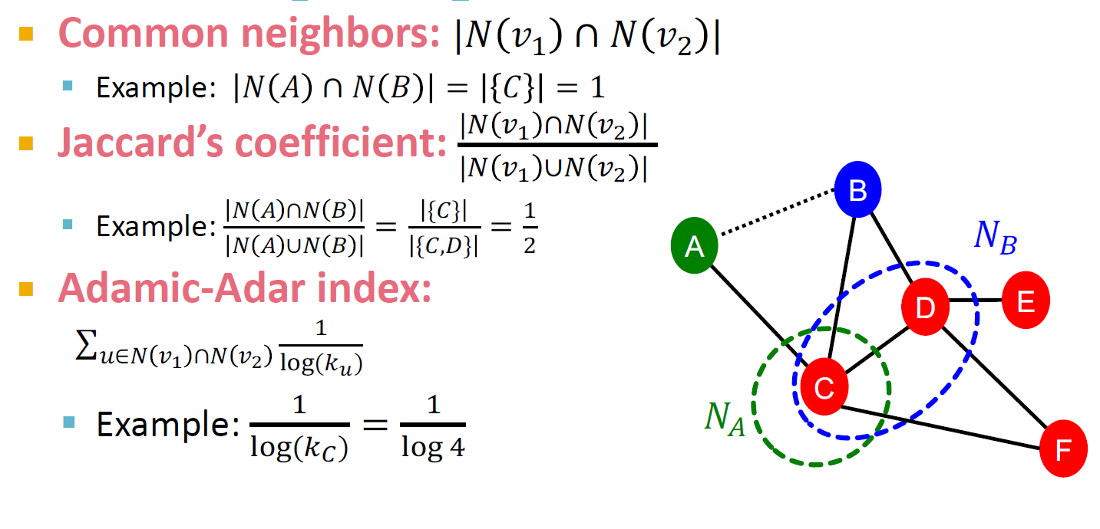
Captures # neighboring nodes shared between two nodes 𝒗_{𝟏} and 𝒗_{𝟐}:

Slide 33
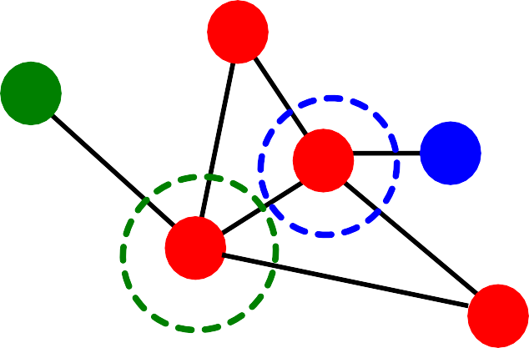
Limitation of local neighborhood features:
Metric is always zero if the two nodes do not have any neighbors in common.
B
𝑁.
A
D
E
𝑁_{A} ∩ 𝑁_{E} = 𝜙
|𝑁_{A} ∩ 𝑁_{E} | = 0
C
𝑁_{A}
F
However, the two nodes may still potentially be connected in the future.
Global neighborhood overlap metrics resolve the limitation by considering the entire graph.

Slide 34
Katz index: count the number of paths of all lengths between a given pair of nodes.
Q: How to compute #paths between two nodes?
Use powers of the graph adjacency matrix!

Slide 35
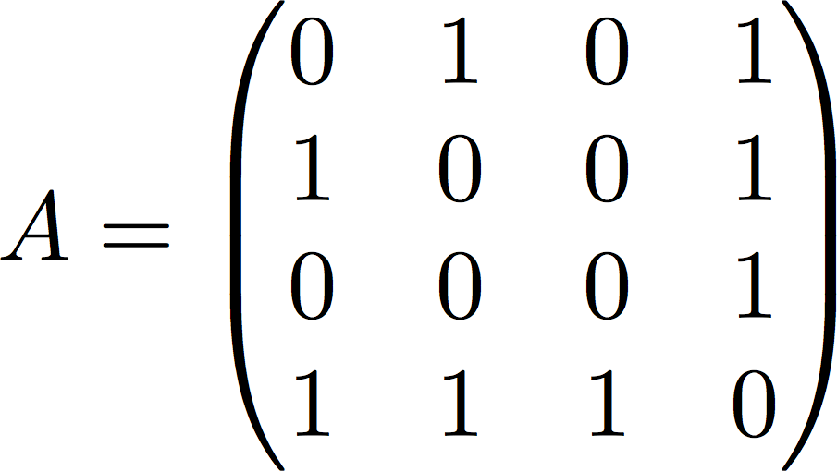




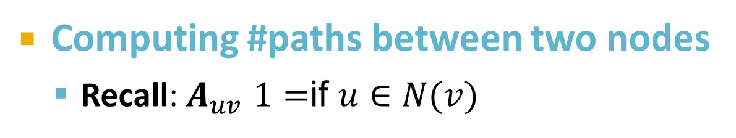
Computing #paths between two nodes
Recall: $A_{uv}$= 1 if 𝑢 ∈ 𝑁(𝑣)
Let 𝑷^{(𝑲)} = #paths of length 𝑲 between 𝒖 and 𝒗
𝒖𝒗
We will show 𝑷^{(𝑲)} = 𝑨^{𝒌}
𝑷^{(𝟏)} = #paths of length 1 (direct neighborhood)
𝒖𝒗
between 𝑢 and 𝑣 = 𝑨_{𝒖𝒗}
_{𝑷}(𝟏) _{= 𝑨𝟏𝟐}
𝟏𝟐
4
3
2
1

Slide 36
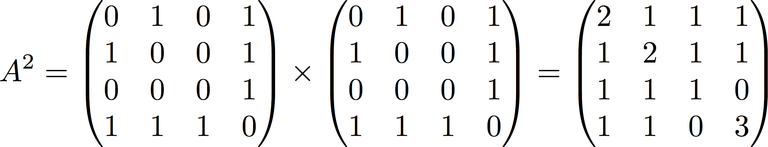
How to compute 𝑷^{(𝟐)} ?
𝒖𝒗
Step 1: Compute #paths of length 1 between each of 𝒖’s neighbor and 𝒗
Step 2: Sum up these #paths across u’s neighbors
𝑷^{(𝟐)} = ∑_{𝒊} 𝑨_{𝒖𝒊} ∗ 𝑷^{(𝟏)} = ∑ 𝑨_{𝒖𝒊} ∗ 𝑨_{𝒊𝒗} = 𝑨^{𝟐}
𝒖𝒗 𝒊
𝒖𝒗
𝒊𝒗
#paths of length 1 between Node 1’s neighbors and Node 2
_{𝑷}(𝟐) _{= 𝑨2}
Node 1’s neighbors
𝟏𝟐
12
Power of adjacency

Slide 37
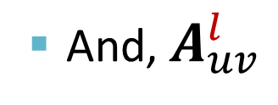
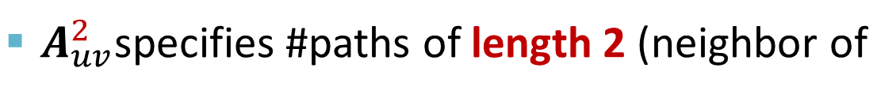
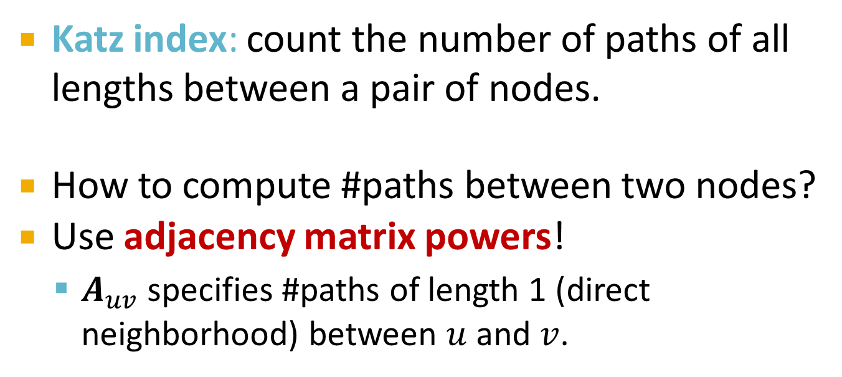
Katz index: count the number of paths of all lengths between a pair of nodes.
How to compute #paths between two nodes?
Use adjacency matrix powers!
$A_{uv}$specifies #paths of length 1 (direct neighborhood) between 𝑢 and 𝑣.
$A_{uv}^{2}$specifies #paths of length 2 (neighbor of
neighbor) between 𝑢 and 𝑣.
And, $A_{uv}^{l}$
specifies #paths of length 𝒍.

Slide 38
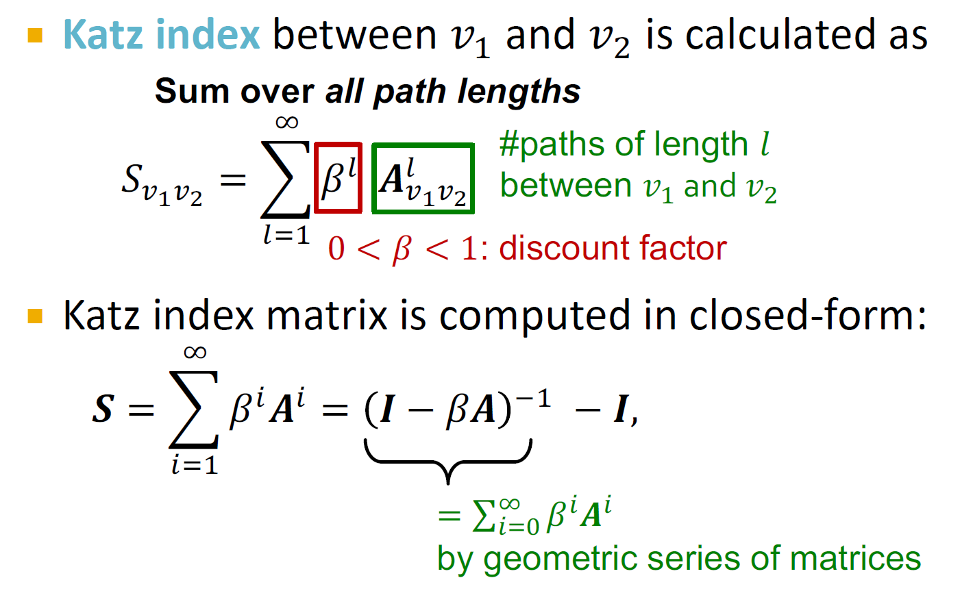

Slide 39
Distance-based features:
Uses the shortest path length between two nodes but does not capture how neighborhood overlaps.
Local neighborhood overlap:
Captures how many neighboring nodes are shared by two nodes.
Becomes zero when no neighbor nodes are shared.
Global neighborhood overlap:
Uses global graph structure to score two nodes.
Katz index counts #paths of all lengths between two nodes.

Slide 40
Graph-Level Features and
Graph Kernels

Slide 41

Goal: We want features that characterize the structure of an entire graph.
For example:
B
F
A
D
E
G
C
H
41

Slide 42
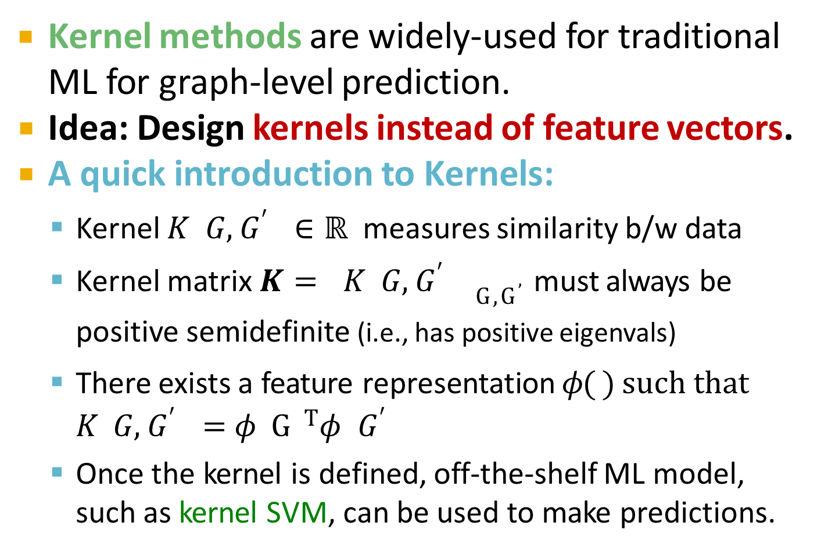
Kernel methods are widely-used for traditional ML for graph-level prediction.
Idea: Design kernels instead of feature vectors.
A quick introduction to Kernels:
Kernel 𝐾 𝐺, 𝐺$′$ ∈ ℝ measures similarity b/w data
Kernel matrix 𝑲 = 𝐾 𝐺, 𝐺$′$ _{G,G}$’$must always be positive semidefinite (i.e., has positive eigenvals)
There exists a feature representation 𝜙( ) such that
𝐾 𝐺, 𝐺$′$ = 𝜙 G ^{T}𝜙 𝐺$′$
Once the kernel is defined, off-the-shelf ML model, such as kernel SVM, can be used to make predictions.
·
42

Slide 43
Graph Kernels: Measure similarity between two graphs:
Graphlet Kernel [1]
Weisfeiler-Lehman Kernel [2]
Other kernels are also proposed in the literature
(beyond the scope of this lecture)
Random-walk kernel
Shortest-path graph kernel
And many more…
Shervashidze, Nino, et al. "Efficient graphlet kernels for large graph comparison." Artificial Intelligence and Statistics. 2009.
Shervashidze, Nino, et al. "Weisfeiler-lehman graph kernels." Journal of Machine Learning Research 12.9 (2011).
43

Slide 44
Goal: Design graph feature vector 𝜙 𝐺
Key idea: Bag-of-Words (BoW) for a graph
Recall: BoW simply uses the word counts as features for documents (no ordering considered).
Naïve extension to a graph: Regard nodes as words.
Since both graphs have 4 red nodes, we get the same feature vector for two different graphs…
𝜙( ) = 𝜙
44

Slide 45
What if we use Bag of node degrees?
Deg1: Deg2: Deg3:
𝜙( ) = count(
𝜙( ) = count(
) = [1, 2, 1]
Obtains different features for different graphs!
) = [0, 2, 2]
Both Graphlet Kernel and Weisfeiler-Lehman (WL) Kernel use Bag-of-* representation of graph, where * is more sophisticated than node degrees!
45

Slide 46

Key idea: Count the number of different graphlets in a graph.
Note: Definition of graphlets here is slightly different from node-level features.
The two differences are:
Nodes in graphlets here do not need to be connected (allows for isolated nodes)
The graphlets here are not rooted.
Examples in the next slide illustrate this.

Slide 47
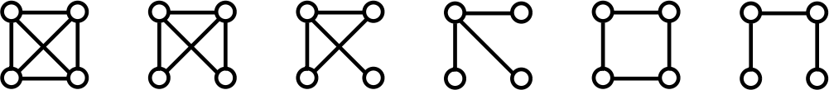
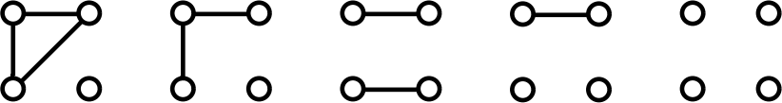
Let 𝓖_{𝒌}=(𝒈_{𝟏,} 𝒈_{𝟐}, … , 𝒈_{𝒏𝒌} ) be a list of graphlets of size 𝒌.
For 𝑘 = 3 , there are 4 graphlets.
For 𝑘 = 4 , there are 11 graphlets.
Shervashidze et al., AISTATS 2011

Slide 48
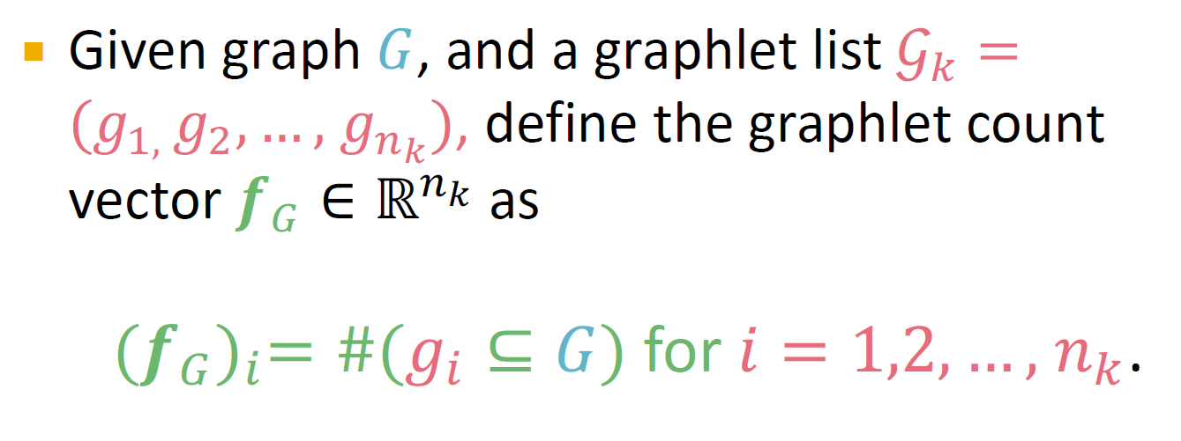
Given graph 𝐺, and a graphlet list 𝒢. = (𝑔_{),} 𝑔*, … , 𝑔/" ), define the graphlet count
vector 𝒇₀ ∈ ℝ/" as
(𝒇!)" = #(𝑔" ⊆ 𝐺) for 𝑖 = 1,2, … , 𝑛#.

Slide 49
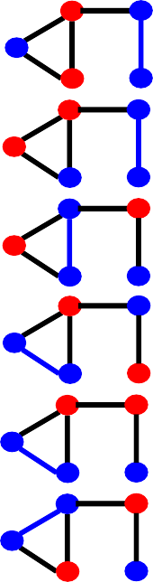


Example for 𝑘 = 3.
𝑔₄
𝑔₁
𝑔₂
𝑔₃
𝐺
𝒇_{G} = (1,
3,
6,
0)^{T}

Slide 50

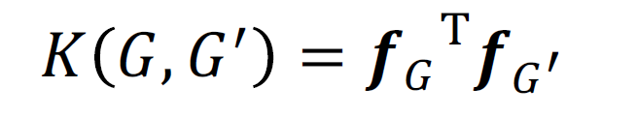
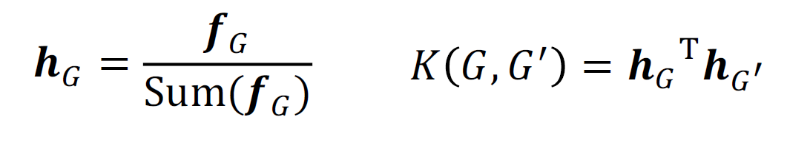
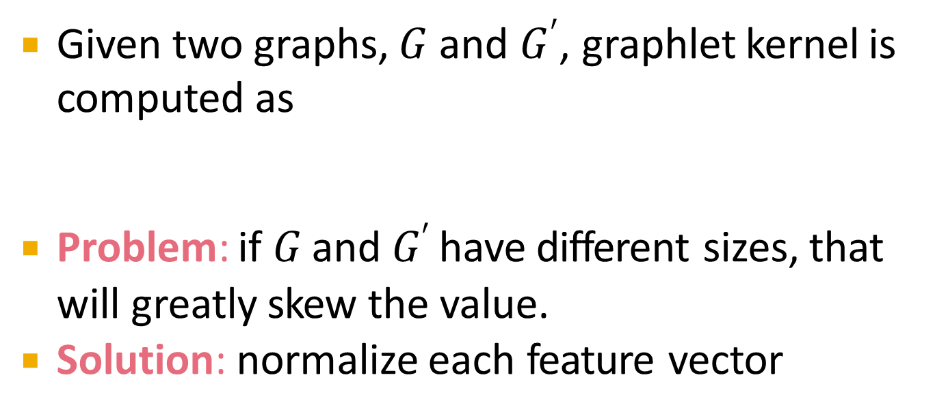
Given two graphs, 𝐺 and 𝐺$′$, graphlet kernel is computed as
Problem: if 𝐺 and 𝐺$′$ have different sizes, that will greatly skew the value.
Solution: normalize each feature vector

Slide 51
Limitations: Counting graphlets is expensive!
Counting size-𝑘 graphlets for a graph with size 𝑛
by enumeration takes 𝑛^{k}.
This is unavoidable in the worst-case since subgraph isomorphism test (judging whether a
graph is a subgraph of another graph) is NP-hard.
If a graph’s node degree is bounded by 𝑑, an
𝑂(𝑛𝑑^{k-1)}) algorithm exists to count all the graphlets of size 𝑘.
Can we design a more efficient graph kernel?

Slide 52
Goal: design an efficient graph feature descriptor 𝜙 𝐺
Idea: use neighborhood structure to iteratively enrich node vocabulary.
Generalized version of Bag of node degrees since node degrees are one-hop neighborhood information.
Algorithm to achieve this:
Color refinement

Slide 53

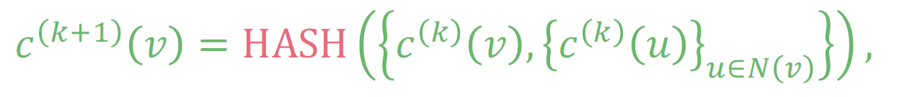
Given: A graph 𝐺 with a set of nodes 𝑉.
Assign an initial color 𝑐 ⁰ 𝑣 to each node 𝑣.
Iteratively refine node colors by
where HASH maps different inputs to different colors.
After 𝐾 steps of color refinement, 𝑐 ^{K} 𝑣
summarizes the structure of 𝐾-hop neighborhood

Slide 54

Example of color refinement given two graphs
Assign initial colors
1
1 1
1
1
1
1
1
1 1
Aggregate neighboring colors
1
1
1,111
1,11
1,11
1,111
1,1111
1,111
1,1111
1,111
1,1
1,1
1,1
1,1

Slide 55
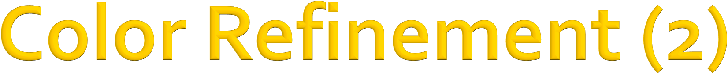
Example of color refinement given two graphs
Aggregated colors
1,111 1,11
1,11 1,111
1,1111
1,111
1,1111
1,111
1,1
1,1
1,1
1,1
Hash aggregated colors
Hash table
4
3
3
4
1,1 | --> | 2
1,11 | --> | 3
1,111 | --> | 4
1,1111 | --> | 5
5
4
5
4
2
2
2
2

Slide 56

Example of color refinement given two graphs
Aggregated colors
4
3
3 4
5
4
5
4
2 2
Hash aggregated colors
2
2
3,45
4,345
4,345
3,44
5,2244
4,345
5,2344
4,245
2,5
2,5
2,5
2,4

Slide 57

Example of color refinement given two graphs
Aggregated colors
3,45 4,345
4,345 3,44
5,2244
4,345
5,2344
4,245
2,5
2,5
2,5 2,4
Hash table
Hash aggregated colors
11
8
9
11
2,4 | --> | 6
2,5 | --> | 7
3,44 | --> | 8
3,45 | --> | 9
4,245 | --> | 10
4,345 | --> | 11
5,2244 | --> | 12
5,2344 | --> | 13
12
11
13
10
7
7
7
6

Slide 58
After color refinement, WL kernel counts number of nodes with a given color.
Colors 1,2,3,4,5,6,7,8,9,10,11,12,13
= [6,2,1,2,1,0,2,1,0, 0, 2, 1, 0]
Counts
𝜙(
𝜙(
)
)
1,2,3,4,5,6,7,8,9,10,11,12,13
= [6,2,1,2,1,1,1,0,1, 1, 1, 0, 1]

Slide 59
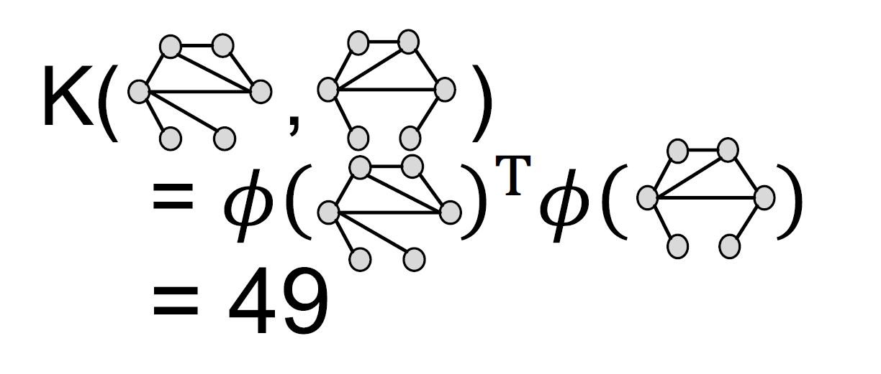

The WL kernel value is computed by the inner product of the color count vectors:
50

Slide 60
WL kernel is computationally efficient
The time complexity for color refinement at each step is linear in #(edges), since it involves aggregating neighboring colors.
When computing a kernel value, only colors appeared in the two graphs need to be tracked.
Thus, #(colors) is at most the total number of nodes.
Counting colors takes linear-time w.r.t. #(nodes).
In total, time complexity is linear in #(edges).
2/14/21
61

Slide 61
Graphlet Kernel
Graph is represented as Bag-of-graphlets
Computationally expensive
Weisfeiler-Lehman Kernel
Apply 𝐾-step color refinement algorithm to enrich node colors
Different colors capture different 𝐾-hop neighborhood structures
Graph is represented as Bag-of-colors
Computationally efficient
Closely related to Graph Neural Networks (as we will see!)
61

Slide 62

Traditional ML Pipeline
Hand-crafted feature + ML model
Hand-crafted features for graph data
Node-level:
Node degree, centrality, clustering coefficient, graphlets
Link-level:
Distance-based feature
local/global neighborhood overlap
Graph-level:
Graphlet kernel, WL kernel
Acknowledgement: Jure Leskovec, Stanford University

